Slide 1
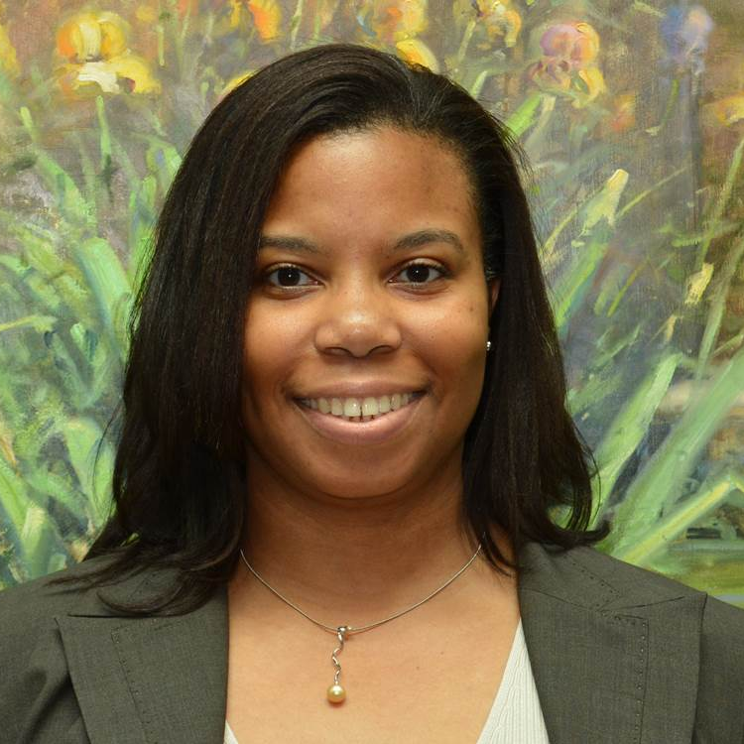
Genara Andrade
New Business Development Leader, Americas
DuPont Industrial Solutions
Genara is responsible for identifying new market opportunities requiring innovative technology solutions that build on the core capabilities of the Industrial Solutions businesses. During her career she held a variety of roles in technology, including new product development, technical marketing, and engineering/technology leadership. Genara holds a PhD in Organic Chemistry from the Georgia Institute of Technology.
Genara is actively engaged in DuPont’s Diversity, Equity & Inclusion initiatives related to PhD recruiting, STEM outreach, and employee development.

